Slide 1
HTML Forms

Slide 2
HTML Forms
HTML Forms are required when you want to collect some data from the site visitor.
For example, during user registration you would like to collect information such as name, email address, credit card, etc.

Slide 3
HTML Forms
A form will take input from the site visitor and then will post it to a back-end application such as CGI, ASP Script or PHP script etc.
The back-end application will perform required processing on the passed data based on defined business logic inside the application.

Slide 4
HTML Forms
There are various form elements available like text fields, textarea fields, dropdown menus, radio buttons, checkboxes, etc.

Slide 5
HTML Forms
The HTML <form> tag is used to create an HTML form and it has following syntax:
<form action="Script URL” method="GET|POST">
form elements like input, textarea etc.
</form>

Slide 6
Form Attributes
Apart from common attributes, following is a list of the most frequently used form attributes:
action
Backend script ready to process your passed data.
method
Method to be used to upload data.
The most frequently used are GET and POST methods.

Slide 7
Form Attributes
target
Specify the target window or frame where the result of the script will be displayed.
It takes values like _blank, _self, _parent etc.

Slide 8
Form Attributes
Enctype
You can use the enctype attribute to specify how the browser encodes the data before it sends it to the server.
Possible values are:
application/x-www-form-urlencoded –
This is the standard method most forms use in simple scenarios.
mutlipart/form-data –
This is used when you want to upload binary data in the form of files like image, word file etc.

Slide 9
HTML Form Controls
There are different types of form controls that you can use to collect data using HTML form:
Text Input Controls
Checkboxes Controls
Radio Box Controls
Select Box Controls
File Select boxes
Hidden Controls
Clickable Buttons
Submit and Reset Button

Slide 10
Text Input Controls
There are three types of text input used on forms:
Single-line text input controls –
This control is used for items that require only one line of user input, such as search boxes or names.
They are created using HTML <input> tag.

Slide 11
Text Input Controls
Password input controls –
This is also a single-line text input but it masks the character as soon as a user enters it.
They are also created using HTML <input> tag.
Multi-line text input controls –
This is used when the user is required to give details that may be longer than a single sentence.
Multi-line input controls are created using HTML <textarea> tag.

Slide 12
Single-line text input controls
This control is used for items that require only one line of user input, such as search boxes or names.
They are created using HTML <input> tag.
Here is a basic example of a single-line text input used to take first name and last name:

Slide 13
Single-line text input controls
<html>
<head>
<title>Text Input Control</title>
</head>
<body>
<form >
First name: <input type="text" name="first_name" />
<br>
Last name: <input type="text" name="last_name" />
</form>
</body>
</html>

Slide 14

Single-line text input controls
This will produce following result:

Slide 15
Single-line text input controls
Attributes
Following is the list of attributes for <input> tag for creating text field.
type
Indicates the type of input control and for text input control it will be set to text.

Slide 16
Single-line text input controls
name
Used to give a name to the control which is sent to the server to be recognized and get the value.
value
This can be used to provide an initial value inside the control.

Slide 17
Single-line text input controls
size
Allows to specify the width of the text-input control in terms of characters.
maxlength
Allows to specify the maximum number of characters a user can enter into the text box.

Slide 18
Password input controls
This is also a single-line text input but it masks the character as soon as a user enters it.
They are also created using HTML <input> tag but type attribute is set to password.
Here is a basic example of a single-line password input used to take user password:

Slide 19
Password input controls
<html>
<head>
<title>Password Input Control</title>
</head>
<body>
<form >
User ID : <input type="text" name="user_id" />
<br>
Password: <input type="password" name="password" />
</form>
</body>
</html>

Slide 20

Password input controls
This will produce following result:

Slide 21
Password input controls
Attributes
type
Indicates the type of input control and for password input control it will be set to password.
name
Used to give a name to the control which is sent to the server to be recognized and get the value.

Slide 22
Password input controls
value
This can be used to provide an initial value inside the control.
size
Allows to specify the width of the text-input control in terms of characters.
maxlength
Allows to specify the maximum number of characters a user can enter into the text box.

Slide 23
Multiple-Line Text Input Controls
This is used when the user is required to give details that may be longer than a single sentence.
Multi-line input controls are created using HTML <textarea> tag.
Here is a basic example of a multi-line text input used to take item description:

Slide 24
Multiple-Line Text Input Controls
<html>
<head>
<title>Multiple-Line Input Control</title>
</head>
<body>
<form>
Description : <br />
<textarea rows="5" cols="50" name="description">
Enter description here...
</textarea>
</form>
</body>
</html>

Slide 25
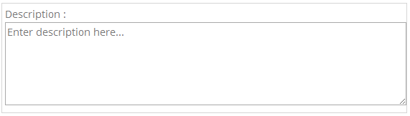
Multiple-Line Text Input Controls
This will produce following result:

Slide 26
Multiple-Line Text Input Controls
Following is the list of attributes for <textarea> tag.
name
Used to give a name to the control which is sent to the server to be recognized and get the value.
rows
Indicates the number of rows of text area box.
cols
Indicates the number of columns of text area box

Slide 27
Checkbox Control
Checkboxes are used when more than one option is required to be selected.
They are also created using HTML <input> tag but type attribute is set to checkbox.
Here is an example HTML code for a form with two checkboxes:

Slide 28
Checkbox Control
<html>
<head>
<title>Checkbox Control</title>
</head>
<body>
<form>
<input type="checkbox" name="maths" value="on"> Maths
<input type="checkbox" name="physics" value="on"> Physics
</form>
</body>
</html>

Slide 29
Checkbox Control
This will produce following result:

Slide 30
Checkbox Control
Attributes
Following is the list of attributes for checkbox.
type
Indicates the type of input control and for checkbox input control it will be set to checkbox.

Slide 31
Checkbox Control
name
Used to give a name to the control which is sent to the server to be recognized and get the value.
value
The value that will be used if the checkbox is selected.
checked
Set to checked if you want to select it by default.

Slide 32
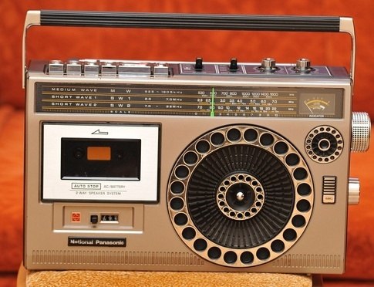
Radio Button Control
Radio buttons are used when out of many options, just one option is required to be selected.
They are also created using HTML <input> tag but type attribute is set to radio.
Here is example HTML code for a form with two radio buttons:

Slide 33
Radio Button Control
<html>
<head>
<title>Radio Box Control</title>
</head>
<body>
<form>
<input type="radio" name="subject" value="maths"> Maths
<input type="radio" name="subject" value="physics"> Physics
</form>
</body>
</html>

Slide 34
Radio Button Control
This will produce following result:

Slide 35
Radio Button Control
Attributes
Following is the list of attributes for radio button.
type
Indicates the type of input control and for radio button input control it will be set to radio.

Slide 36
Radio Button Control
name
Used to give a name to the control which is sent to the server to be recognized and get the value.
value
The value that will be used if the radio box is selected.
checked
Set to checked if you want to select it by default.

Slide 37
Select Box Control
A select box, also called drop down box which provides option to list down various options in the form of drop down list, from where a user can select one or more options.
Here is example HTML code for a form with one drop down box.

Slide 38
Select Box Control
<html>
<head>
<title>Select Box Control</title>
</head>
<body>
<form>
<select name="dropdown">
<option value="Maths" selected>Maths</option>
<option value="Physics">Physics</option>
</select>
</form>
</body>
</html>

Slide 39

Select Box Control
This will produce following result:

Slide 40
Select Box Control
Attributes
Following is the list of important attributes of <select> tag:
name
Used to give a name to the control which is sent to the server to be recognized and get the value.
size
This can be used to present a scrolling list box.
multiple
If set to "multiple" then allows a user to select multiple items from the menu.

Slide 41
Select Box Control
Following is the list of important attributes of <option> tag:
value
The value that will be used if an option in the select box is selected.
selected
Specifies that this option should be the initially selected value when the page loads.
label
An alternative way of labeling options

Slide 42
File Upload Box
If you want to allow a user to upload a file to your web site, you will need to use a file upload box, also known as a file select box.
This is also created using the <input> element but type attribute is set to file.
Here is example HTML code for a form with one file upload box:

Slide 43
File Upload Box
<html>
<head>
<title>File Upload Box</title>
</head>
<body>
<form>
<input type="file" name="fileupload" accept="image/*" />
</form>
</body>
</html>

Slide 44
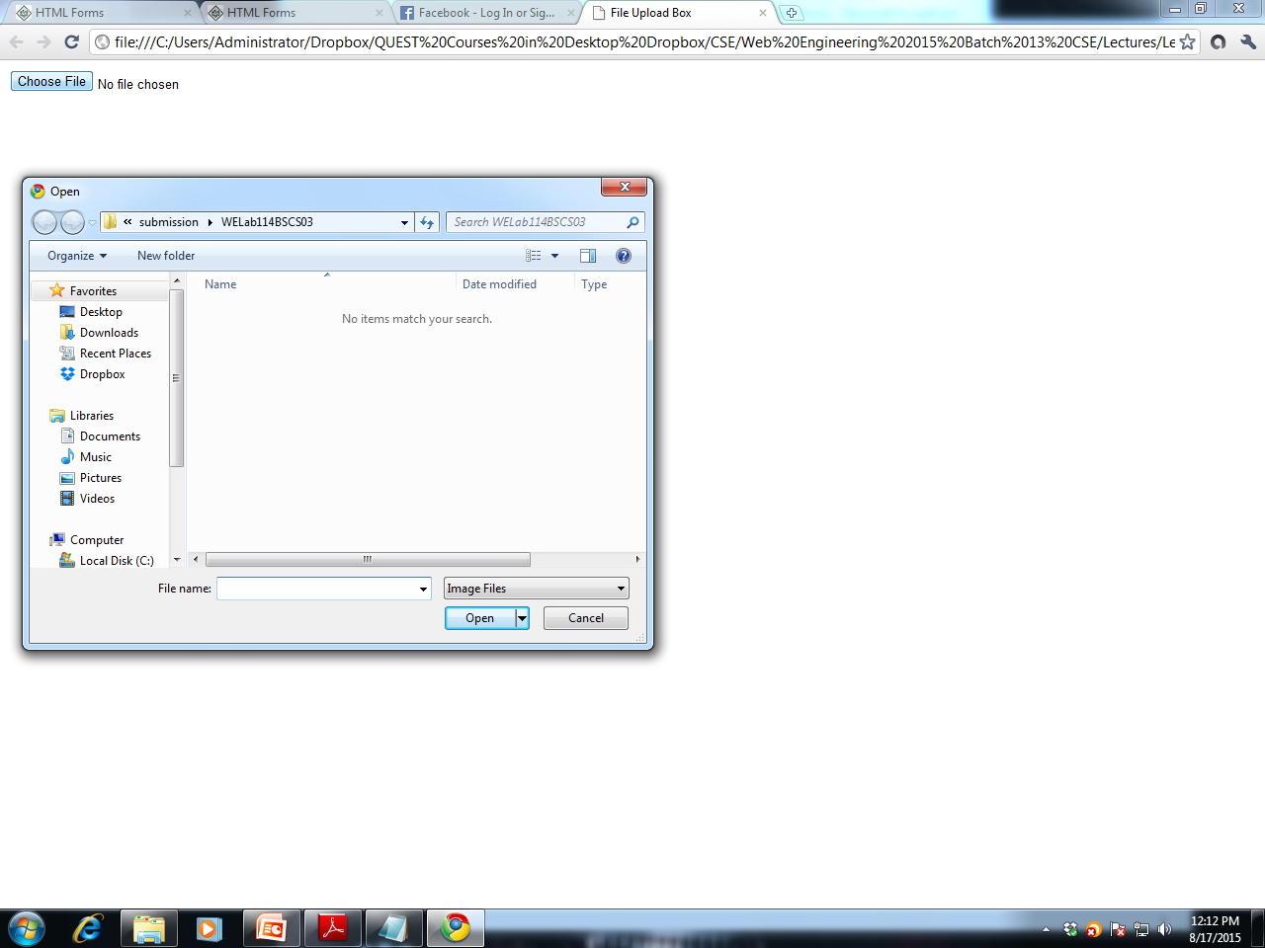
File Upload Box
This will produce following result:

Slide 45
File Upload Box
Attributes
Following is the list of important attributes of file upload box:
name
Used to give a name to the control which is sent to the server to be recognized and get the value.
accept
Specifies the types of files that the server accepts.

Slide 46
Button Controls
There are various ways in HTML to create clickable buttons.
You can also create a clickable button using <input> tag by setting its type attribute to button.
The type attribute can take the following values:

Slide 47
Button Controls
submit
This creates a button that automatically submits a form.
reset
This creates a button that automatically resets form controls to their initial values.
button
This creates a button that is used to trigger a client-side script when the user clicks that button.
image
This creates a clickable button but we can use an image as background of the button.

Slide 48
Button Controls
<html>
<head>
<title>File Upload Box</title>
</head>
<body>
<form>
<input type="submit" name="submit" value="Submit" />
<input type="reset" name="reset" value="Reset" />
<input type="button" name="ok" value="OK" />
<input type="image" name="imagebutton" src="/html/images/logo.png" />
</form>
</body>
</html>

Slide 49
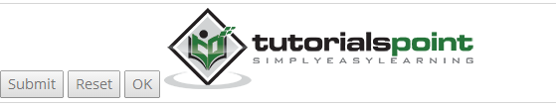
Button Controls
This will produce the following result

Slide 50
Hidden Form Controls
Hidden form controls are used to hide data inside the page which later on can be pushed to the server.
This control hides inside the code and does not appear on the actual page.
For example, following hidden form is being used to keep current page number.
When a user will click next page then the value of hidden control will be sent to the web server and there it will decide which page has be displayed next based on the passed current page.

Slide 51
Hidden Form Controls
<html>
<head>
<title>File Upload Box</title>
</head>
<body>
<form>
<p>This is page 10</p>
<input type="hidden" name="pagename" value="10" />
<input type="submit" name="submit" value="Submit" />
<input type="reset" name="reset" value="Reset" />
</form> </body> </html>

Slide 52
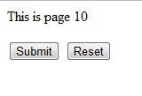
Hidden Form Controls
This will produce following result:

